Slide 1
Convolutional Neural Networks for Visual Recognition
Summer 2020

Slide 2
“Big Wins” for Artificial Neural Networks
As we saw earlier in this module, Artificial Neural Networks have been around for a long time.
Their most impressive achievements, however, have been more recent, and have been most impressive on problems where many other modeling techniques struggle: unstructured data.
Unstructured data are those data that do not fit well (or meaningfully) in the “data frame” style we saw with the earlier data set. Important examples include:
Digit Identification: One early example is the recognition of digits on handwritten envelopes.
Object Recognition in Images: cat is a cat, regardless of where in the image the cat is, how the cat is oriented, what posture it is taking, etc.
Language: The interpretation of words depends on context, order, etc. Important parts of speech need not be located in the same place in a block of text or speech.
The success of neural networks at these complex tasks can be attributed, in part, to advanced network architecures.

Slide 3
Convolutional Neural Networks
Convolutional Neural Networks add two types of layers:
Convolutional Layers, which use the same weights on sliding windows across the entire image
Pooling Layers, where output from earlier layers is combined and reduced.
These layers provide at least two benefits:
Provide a way to recognize signals (and therefore objects) no matter where they are located in the image.
Reduce the total number of weights learned in the network, improving training.

Slide 4
Convolutional Layer
The convolutional layer can be viewed as a set of filters, which have been trained to recognize certain structures in the image.
We slide each filter across the width and height of the image and “examine” what is in that window.
The weights in these filters are fixed no matter which part of the image they are examining.
Each filter is to see some type of visual feature such as an edge of some orientation or a blotch of some color, or eventually entire honeycomb or wheel-like patterns

Slide 5
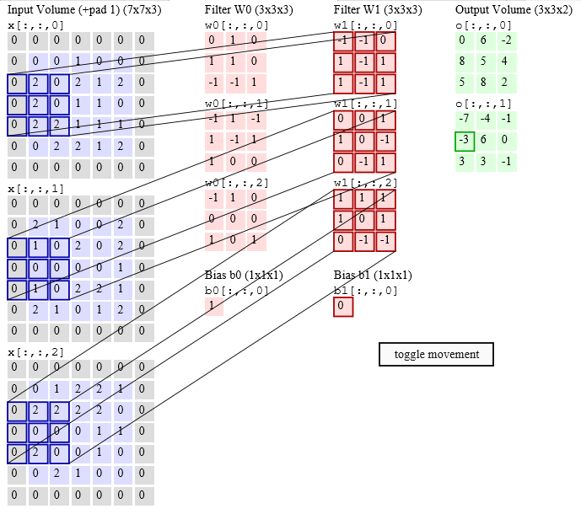
Convolutional Layer
Visit: http://cs231n.github.io/assets/conv-demo/index.html for an illustration.
Notes:
The instructor should take the time to go to the website and walk students through this animation. It describes very well how the filter works in such a network.

Slide 6
Pooling Layer
This type of layer is to progressively reduce the spatial size of the representation to reduce the amount of parameters and computation in the network, and hence to also control overfitting.
Two popular types of pooling layers are “Max Pooling” and “Average Pooling”. These layers select the maximum or average value of activations over an area of the image, rather than every activation.

Slide 7
Convolutional Layers in Keras
“Kernel_Size”: How many pixels (square) should each filter examine.
Number of Filters
## Convolutional Layer
model.add(Conv2D(64, 8, 8, input_shape=(64, 64, 1), padding='same', activation='relu'))
## Pooling Layer
model.add(MaxPool2D(pool_size=(2, 2)))
“Stride”: How many pixels to slide the filter at each step.
Size of the Region to pool
Warning: Making sure that dimensions make sense can be more challenging convolutional networks than in feed forward.

Slide 8
For Further Study
Want more details?
http://cs231n.github.io/convolutional-networks/
https://www.youtube.com/watch?v=u6aEYuemt0M

